Slide 1
Fake News Detection
Notes:
Don’t move computer
Speak slowly

Slide 2
Presentation
Relevance of project
Data
Part 1: Classification
Part 2: Dynamic Word Embeddings
Conclusion
(Expanding on word embeddings)
Questions and discussion
Notes:
Johan Horsmans
Feel free to interrupt me if you have any questions.

Slide 3
Relevance of project

Slide 4
Relevance of project
Fake News misleads
Notes:
Common definition of Fake News:
False or misleading information presented as news
Obviously, Fake News has a negative impact
Influences public opinion and thus foreign and domestic policies around the world -> most notably Covid-19 vaccinations and US elections

Slide 5
Relevance of project
Fake News misleads
ML approaches show promising results
Notes:
Unfeasible to try and manually detect Fake News in the stream of news that takes place across platforms
Automatic approach is preferred -> Previous ML studies high classif.
Ahmed et al., (mentioned in synopsis)
92% accuracy
Just using relatively simple model with TF-IDF’s as features
BUT!

Slide 6
Relevance of project
Fake News misleads
ML approaches show promising results
BUT! Generalizability?
Across datasets
Across time
Notes:
BUT! Generalizability?
We theorized:
Across datasets / sources
Across time
Other fields have these problems -> publishing paper with Riccardo

Slide 7

Relevance of project
We wanted to investigate:
Notes:
With off-set in the previously mentioned point, the scope of our project was to investigate:

Slide 8
Relevance of project
We wanted to investigate:
The potential lack of generalizability in the field
Notes:
The potential lack of generalizability in the field
Train 2 models on two different datasets and cross-test

Slide 9
Relevance of project
We wanted to investigate:
The potential lack of generalizability in the field
The non-staticity of news articles
Notes:
The non-staticity of news articles
By: Exploring dynamic word embeddings across time periods

Slide 10
Data
Notes:
Fundamental role in project

Slide 11
Data
Two datasets:
Dataset 1 (large)
Dataset 2 (small)
Notes:
Dataset 1:
Roughly 45000 entries
Scraped
2015-2017
Dataset 2:
Roughly 300 entries
Carefully selected
2016-2017
Both used in previous research

Slide 12
Data
Two datasets:
Dataset 1 (large)
Dataset 2 (small)
Preprocessing:
Cleaning from manual inspection
Lowercasing, stopwords + special characters, lemmatization
Notes:
Datasat 1 supposedly cleaned, as stated by Victoria University
Systematic patterns, unrelated to articles

Slide 13
Part 1: Classification
Notes:
Assess generalizability across datasets
Train 2 models on two different datasets and cross-test

Slide 14
Part 1: Classification
BERT Base Uncased -
Notes:
Fine-tuned BERT Base Uncased (from HuggingFace), for classification of Fake/Real News

Slide 15
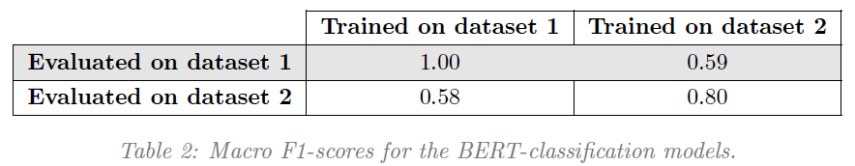
Part 1: Classification
BERT Base Uncased –
Notes:
Poor generalizability
= large drop in performance across datasets = model is overfitting to the specific dataset
Confounding factor -> Dataset 1:
F1-score = 1 -> Alarming – especially since we only ran 3 epochs
We optimized performance for the validation set. This is test-set performances.
Data quality:
Type of Fake News? These entries contain many abbreviations, misspellings, slang.
Seems scraped.
Information Security and Object Technology, states that it has already been cleaned, surprising to us, when we inspected the data
BUT -> Something we missed in cleaning? Possibly
Don’t read too much into these results
It is concerning that Ahmed et al., published two papers.
Dataset 2:
0.80 reasonable
Large drop in performance -> this model more trustworthy results
Smaller dataset, higher quality. Quantity is not the only thing that matters.
Despite confounds -> Models generalize poorly
Data from published research
-> Suggests problem for not only our models, but also for the field? Maybe
This could be accommodated by 2 factors:
1) Assess generalizability of models (cross-test) - Know predictive capabilities in real-world settings.
Open science (sharing scripts and datasets)
2) Data awareness/scepticism
Be wary of dataset quality (avoid unrelated systematic patterns)
Definition of Fake News
Universally accepted
Allows for sharing and expanding datasets
Models would generalize if there was agreement on what we’re classifying? E.g. should satirical fake news be included? They were initially included in dataset 2
Practically applicable:
Steadfast rules for coding whether news articles were Fake or Real.
Johan and I sometimes in doubt.
Streamline datasets for expanding or sharing

Slide 16
Part 2: Dynamic Word Embeddings
Notes:
Analysis 2:
More exploratory in nature
To assess temporal generalizability problems -> better to include BERT models for time periods
More direct, but we also wanted a bit of a challenge

Slide 17
part 2: Dynamic Word Embeddings
Dataset 1 (large) -> Split into 5 periods
Notes:
Split data
Not just ordering by date, and splitting with equal number of entries in each period
Rather ordered by date, split by date

Slide 18
part 2: Dynamic Word Embeddings
Dataset 1 (large) -> Split into 5 periods
Trained fastText skipgram model on each period
Notes:
Trained fastText skipgram model on each period

Slide 19
part 2: Dynamic Word Embeddings
Dataset 1 (large) -> Split into 5 periods
Trained fastText skipgram model on each period
Word embedding for each word, for each period
Notes:
Resulting in a vector representation for each word for each time period.

Slide 20
part 2: Dynamic Word Embeddings
Dataset 1 (large) -> Split into 5 periods
Trained fastText skipgram model on each period
Word embedding for each word, for each period
Found nouns with largest semantic shift
Notes:
Nouns with largest semantic shift between Period 1 and 5

Slide 21
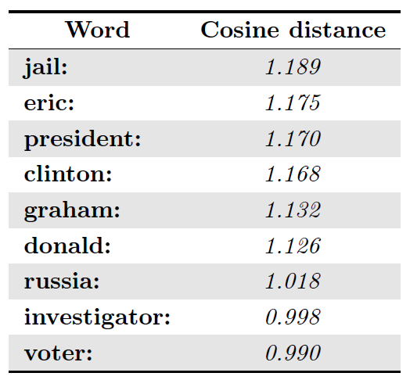
part 2: Dynamic Word Embeddings
Notes:
Semantic shift -> Distance in word embedding space
0.8 means large (some studies suggest, but arbitrary cut-off).
After submitting our synopsis, we, moreover, found some more problems which I might go into later, regarding the use of cosine distances, and comparing vector representations across different embedding spaces.
But only if we have the time.

Slide 22
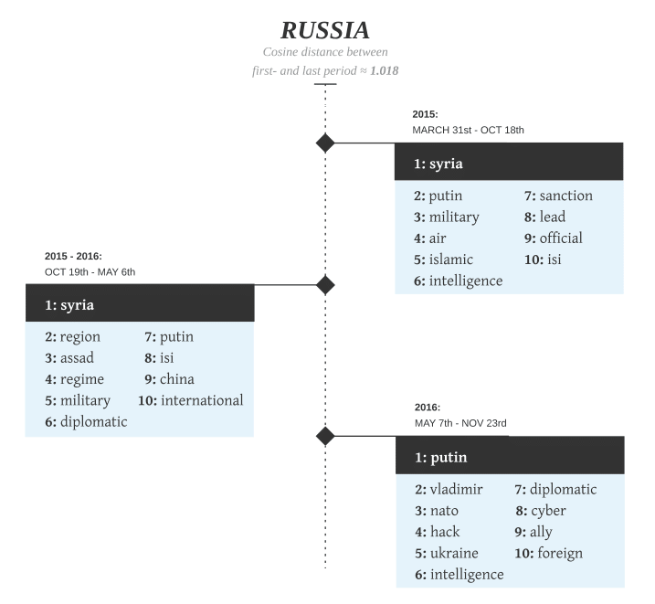
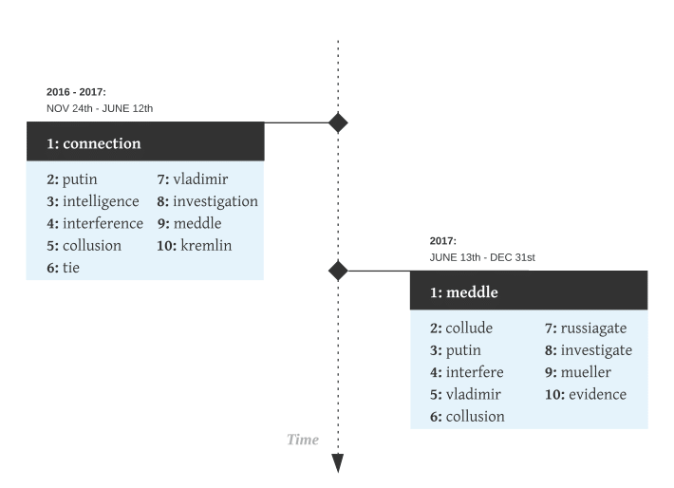
part 2: Dynamic Word Embeddings
Notes:
Explain graph ->
Syria in beginning,
Meddle + Collude in end (US election)
Illustrates how non-staticity interferes with building word-embedding representations that are reliable and generalizable across time periods.
This, in turn, also means that building a model for classification on some dataset from a given period, would not necessarily make the model generalizable to future datasets.
Hypothetically, given a large enough dataset that spans enough time:
Not impossible that a model might learn more general patterns, that are unrelated to time-specific topics of news.
However, not feasible since it requires large datasets spanning a large timeframe. -> Right now, hardly any publicly available data (the large dataset was bad quality, and the small was very small).
Instead, if we want to practically implement these models, we, therefore, need to:
Continually update or retrain models with newest data
However; these results should be taken with a grain of salt:
We handpicked words with most drastic changes in semantics (embedding space). Thus not scientifically rigorous practice -> prove a point.

Slide 23
Conclusion
Notes:
Concluding remarks

Slide 24
Conclusion
Our study suggests:
Low generalizability of models in the field
The task is non-static
Data is important
Notes:
1st analysis: Models generalize poorly.
Data from published research
-> Suggests problem for not only our models, but also for the field? Bad data quality of dataset 1 Maybe
2nd analysis: Illustrated that the task is non-static. Word embeddings change over time.
It should be noted that the particular changes that we showcased were handpicked.
Finally, from both analyses it is apparent that data awareness is important.
1) Low generalizability issues stems from training on non-representative data
2) Be aware of daterange of data, as the task is non-static
2) Be aware of quality -> F1-score of 1 rings alarm bells
3) Data is different across datasets -> No clear definition of how to gather Fake News

Slide 25
Expanding on word embeddings
Notes:
Came to realize problem not mentioned in synopsis

Slide 26
Expanding on word embeddings
Problems of our dynamic word embedding analysis
Notes:
3 problematic factors that I only thought of after finishing our project
1st
Even if we had sampled Fake News and real news randomly from within the same period 5 times. And then had trained 5 models on these 5 datasets, then we would likely ALSO have seen semantic shifts as well as changes in nearest neighbours for the word Russia. Just because the data is different.
2nd problem relates to using cosine distance

Slide 27
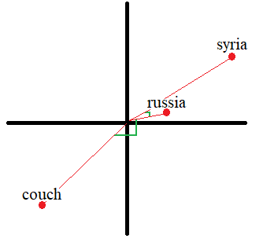
Expanding on word embeddings
Problems of our dynamic word embedding analysis
Notes:
We based our analysis on the fact that distances in embedding space represent semantic similarity
*Explain*
-> Russia is semantically similar to Syria, and dissimilar to Couch

Slide 28
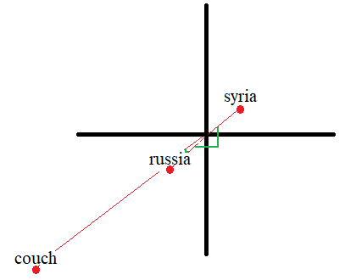
Expanding on word embeddings
Problems of our dynamic word embedding analysis
Notes:
We could also have seen something like this (Right Plot):
Here, the Euclidean distances between words is identical between time first and last time period.
But the Cosine Distances are widely different
*Explain*
This has implications on both which words we found to most dissimilar, but also to which words are the nearest neighbours.
We would perhaps be more interested in Euclidean distances, and not Cosine distances.

Slide 29
Expanding on word embeddings
Problems of our dynamic word embedding analysis
Notes:
Another problematic factor for our analysis relates to comparing vector representations of words, across different word embedding spaces:

Slide 30
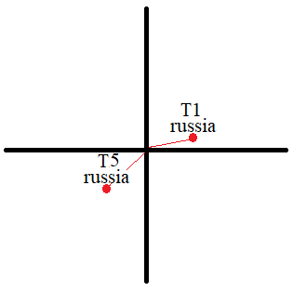
Expanding on word embeddings
Problems of our dynamic word embedding analysis
Time period 1 and 5:
Notes:
What we did (example only 1 word, only 2 dimensions for simplicity):
Computed cosine distance -> as distances in word embedding space relates to semantics
BUT:
They are not found in the same embedding space, which means distances between embeddings spaces cannot necessarily be interpreted as semantic distances.
We could have the following example:

Slide 31
Expanding on word embeddings
Problems of our dynamic word embedding analysis
Time period 1:
Time period 5:
Notes:
Here, our analysis would have perceived to have changed A LOT!
But, the relative distances between Russia and other words remain the same.
Meaning -> Russia would not have changed, semantically, but would appear to, in our analysis.

Slide 32
Notes:
Forstå og lav slides på:
Læs op på: fastText og word embeddings, og fokusér/inkludér på dét til det ekstra (if time).
Hyperparameters, Analysis 1 (eller bare generelt hvordan det fungerer I store træk)
Lav ekstra slides på word embeddings (eller andet(!)) – læs godt op på det
Skriv flere ting på, indtil præsentationen er ca. 11-12 minutter.
Confounds of word embedding analysis:
Not mentioned in synopsis:
Even if we had sampled Fake News and real news randomly from within the same period 5 times. And then had trained 5 models on these 5 datasets, then we would likely ALSO have seen semantic shifts as well as changes in nearest neighbours for the word Russia.
Why use Macro F1-score?
*
Should’ve included classification matrix
Distance metrics
Other distance metrics could have been utilized:
Cosine distance
Euclidean distance
Cosine distance and Euclidean distance are widely different
Use paper and draw (in advance): ??
-0.1,-0.1. vs. 0.1, 0.1
and
1000000000, 1000000000 vs. 1, 1
Which metric is best?
Different uses, BUT:
Perhaps Euclidean distance would have been better for this task.
Preprocessing
Tokenization
By whitespace
How did our method used handle “it’s”
????
Stopword removal?
Removal of frequent, but information-low words.
Reduces noise and lowers computational power needed.
Lemmatization?
Lemmatization -> Grouping together inflected forms of the same word, into the lemma
What is a lemma?
Semantic nucleus of a word
Infinitive for verbs
Singular form for nouns
How is lemmatization carried out?
Two methods:
Look-up table
Morphology based approach (word internal structure to predict lemma, requires trained model)
Which lemmatization method did we use?
?????
What other preprocessing steps could have been utilized?
Instead of lemmatization, we could have used stemming:
Similar to lemmatization, but simpler (and not necessarily humanly interpretable):
Argue, argued, argues, arguing, and argus - > stem = argu
fastText
fastText is an improvement of word2vec, that includes sub-word information.
Looks up subword embeddings, averages, and then this is embedding of the word
BERT base uncased
BERT large, higher scores, but at high computational cost
Datasets?
Size impact:
Small dataset -> Worse learning, poor evaluation metrics (few samples, more inaccurate)
Quaility impact:
Poor generalizability for poor quality

